Slide 1

VACCINATION DATABASE MANAGEMENT SYSTEM
Submitted by:
E S THEJAS 2021-IMT-032
Submitted to:
Dr. DEBANJAN SADHYA

Slide 2
CONTENTS

Slide 3
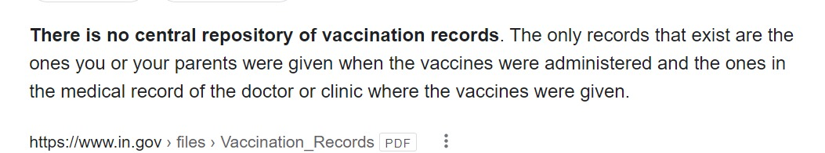
A Gist into the topic
Your vaccination record (sometimes called your immunization record) provides a history of all the vaccines you received as a child and adult. This record may be required for certain jobs, travel abroad, or school registration.
Individual-level vaccination data are critical for the timely evaluation of vaccine coverage, effectiveness and safety at the population level

Slide 4
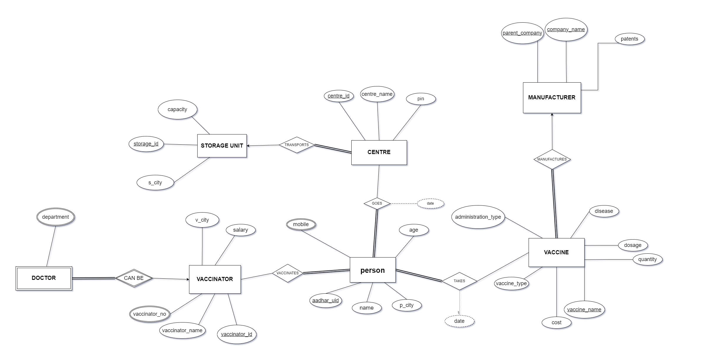
ER Diagram

Slide 5
Assumptions
Every person has to get vaccinated and everyone has an aadhar.
Multiple companies may have same name under different parent companies.

Slide 6
Entity Sets
Storage Unit=
(storage_id, capacity, s_city)
Centre =
(centre_id, centre_name, pin, storage_id)
Vaccinator =
(vaccinator_id, vaccinator_name, vaccinator_no, v_city, salary)

Slide 7
Vaccine =
(vaccine_name, disease, dosage, quantity, vaccine_type,administration_type, company_name, parent_company)
Person =
( aadhar_uid, name, age, mobile, p_city )

Slide 8
Doctor =
(vaccinator_id, department)
Manufacturer =
(company_name,parent_company,patents)

Slide 9
Relationship Sets And Their Cardinalities
Takes ( aadhar_uid , vaccine_name, date)
is a many to many relationship between ‘person’ and ‘vaccine’. One person can take many vaccines and one vaccine can be administered to many people. As every person should get vaccinated, person should have total participation.
Transports
Is a one to many relationship between ‘storage_unit’ and ‘centre’.
One vaccination centre receives vaccines from one storage unit but one storage unit provides vaccines for many centres. Every centre should be connected to one storage unit

Slide 10
Vaccinates (vaccinator_id, aadhar_uid)
is a many to many relationship between ‘person’ and ‘vaccinator’. Where one person gets vaccinated by many vaccinators and one vaccinator can vaccinate many persons.
Goes ( centre_id, aadhar_uid,date)
is a many to many relationship between ‘person’ and ‘centre’. Where a person can go to different centres for different vaccines and a centre can be visited by many people

Slide 11
Manufactures
is a one to many relationship between ‘manufacturer’ and ‘vaccine’. One manufacturer can manufacture many vaccines but one certain vaccine can be manufactured by only one manufacturer. Every vaccine must be manufactured by some manufacturer, hence total participation on vaccine side.
Can_be
Is a weak relationship between ‘doctor’ and ‘vaccinator’. A vaccinator who is a doctor may have been specialised in multiple departments (paediatrics, cardio).

Slide 12
Functional Dependencies
Entity sets | Dependencies
Person | aadhar_uid -> name,age,mobile,p_city
Vaccinator | vaccinator_id -> vaccinator_name, vaccinator_no, v_city, salary
Vaccine | vaccine_name -> disease, cost, vaccine_type, administration_type, doses, quantity, company_name, parent_company disease -> vaccine_type

Slide 13
Entity sets | Dependencies
Manufacturer | company_name, parent_company-> patents parent_company -> patents
Storage Unit | storage_id ->capacity, city
Centre | center_id -> center_name, pin, storage_id
Doctor | -

Slide 14
Relationship sets | Dependencies
Vaccinates | -
Takes | -
Goes | -

Slide 15
Normalisation
1.PERSON
aadhar_id name, age, mobile, city
1NF: Since mobile is a multivalued attribute , it is not in 1NF
Hence, we decompose ‘person’ into
person_details (aadhar_id , name , city, age)
person_phno (aadhar_id, mobile)
2NF:Since there is no partial dependency, It is in 2NF.
3NF:Since there is no transitive dependency , it is in 3NF
BCNF: Since there is no non-prime attribute defining a prime attribute , it is in BCNF

Slide 16
2.VACCINATOR
Vaccinator_id vaccinator_name, vaccinator_no, v_city, salary
1NF: Since ,vaccinator_no is multivalued attribute, it is in 1NF
Hence, we decompose ‘person’ into
vaccinator_details (vaccinator_id, vaccinator_name , city, salary)
vaccinator_PHNO (vaccinator_id, vaccinator_no)
2NF:Since there is no partial dependency, It is in 2NF.
3NF:Since there is no transitive dependency , it is in 3NF
BCNF: Since there is no non-prime attribute defining a prime attribute , it is in BCNF

Slide 17
3.VACCINE
Vaccine_name disease, cost, vaccine_type, administration_type, doses, quantity, company_name, parent_company
Disease vaccine_type
1NF: Since all attributes are atomic, it is in 1NF.
2NF:Since there is no partial dependency, It is in 2NF.
3NF:Since there is a transitive dependency , it is not in 3NF. So we decompose it to
vaccine_details (vaccine_name, disease, cost, administration_type, doses, quantity, company_name, parent_company)
disease_details (disease, vaccine_type)
BCNF: Since there is no non-prime attribute defining a prime attribute , it is in BCNF

Slide 18
4.MANUFACTURER
Company_name, parent_company patents
Parent_company patents
1NF: Since all attributes are atomic, it is in 1NF.
2NF:Since there is a partial dependency, It is not in 2NF.
patent_details ( parent_company, patents)
company_details (company_name, parent_company,)
3NF:Since there is no transitive dependency , it is in 3NF.
BCNF: Since there is no non-prime attribute defining a prime attribute, it is in BCNF.

Slide 19
5.STORAGE UNIT
Storage_id capacity, s_city
1NF: Since all attributes are atomic, it is in 1NF.
2NF:Since there is no partial dependency, It is in 2NF.
3NF:Since there is no transitive dependency , it is in 3NF
BCNF: Since there is no non-prime attribute defining a prime attribute , it is in BCNF

Slide 20
6.CENTRE
Centre_id centre_name, pin, storage_id
1NF: Since all attributes are atomic, it is in 1 NF.
2NF:Since there is no partial dependency, It is in 2NF.
3NF:Since there is no transitive dependency , it is in 3NF
BCNF: Since there is no non-prime attribute defining a prime attribute , it is in BCNF

Slide 21
Final Tables

Slide 22
person_details (aadhar_uid , person_name , p_city, age)
person_phno (aadhar_uid, mobile)
vaccinator_details (vaccinator_id, vaccinator_name , v_city, salary)
vaccinator_phno (vaccinator_id, vaccinator_no)
vaccine_details (vaccine_name, disease, cost, administration_type, doses, quantity, company_name, parent_company)
disease_details (disease, vaccine_type)

Slide 23
patent_details ( parent_company, patents)
company_details (company_name, parent_company)
storage_unit ( storage_id, capacity, s_city)
centre ( centre_id, centre_name, pin, storage_id)
doctor( department , Vaccinator_id)
takes ( aadhar_uid , vaccine_name, date)
vaccinates ( vaccinator_id, aadhar uid)
goes ( centre_id, aadhar_uid,date)

Slide 24
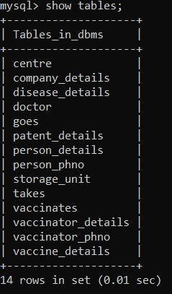
Data entry into Final tables

Slide 25
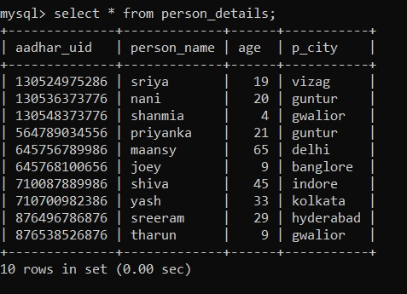
1.PERSON
person_details

Slide 26
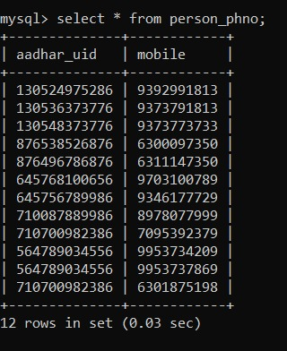
person_phno

Slide 27
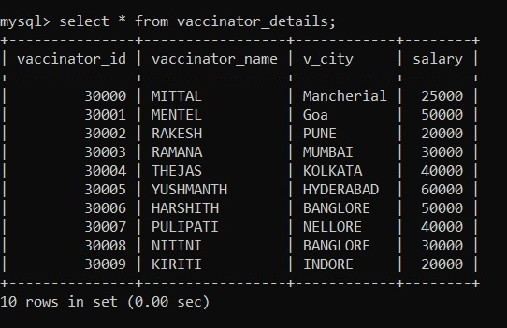
2.VACCINATOR
vaccinator_details

Slide 28
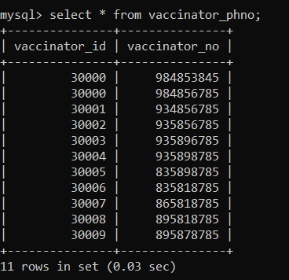
vaccinator_phno

Slide 29
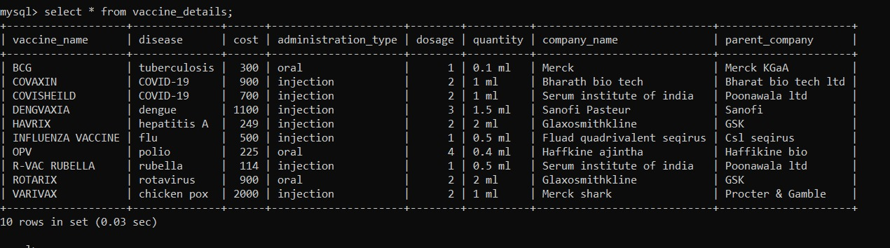
3.VACCINE
vaccine_details

Slide 30
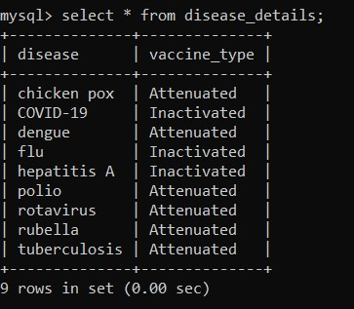
disease_details

Slide 31
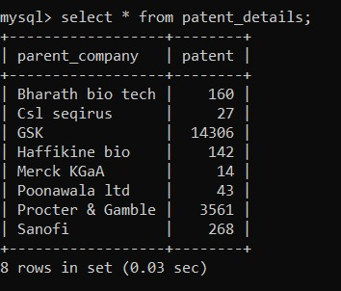
3.MANUFACTURER
patent_details

Slide 32
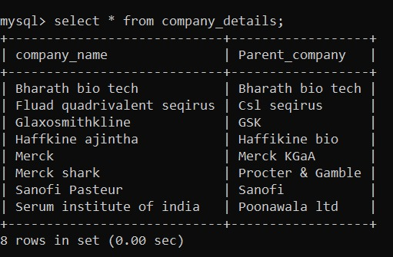
company_details

Slide 33
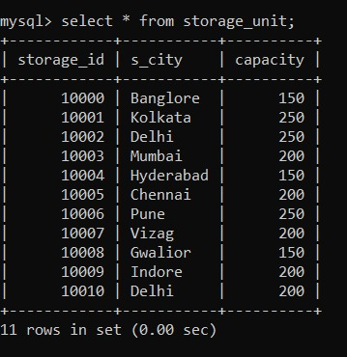
4. STORAGE UNIT

Slide 34
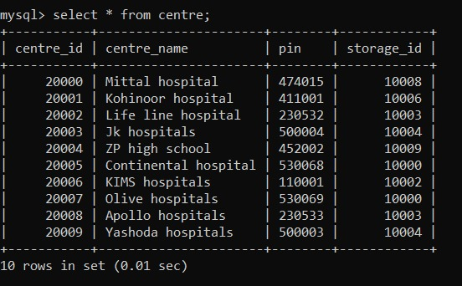
5. CENTRE

Slide 35
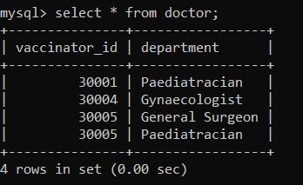
6. DOCTOR

Slide 36
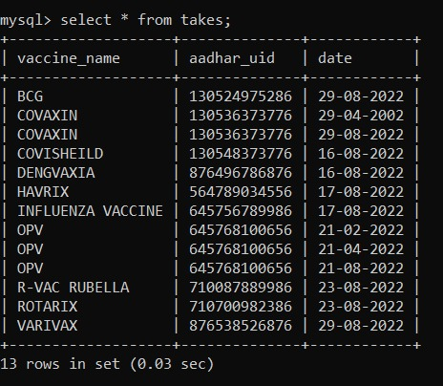
person TAKES vaccine

Slide 37
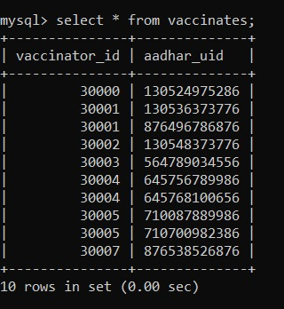
Vaccinator VACCINATES person

Slide 38
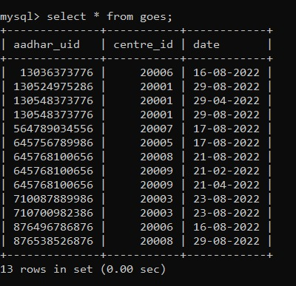
person GOES centre

Slide 39
Queries In SQL

Slide 40
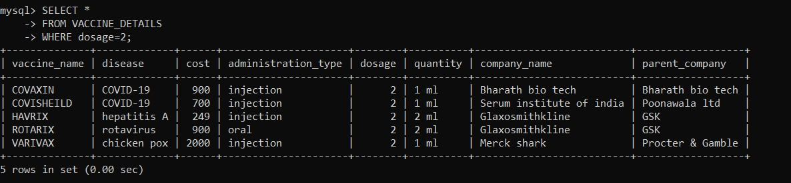
1.Find all the vaccines with two doses.

Slide 41
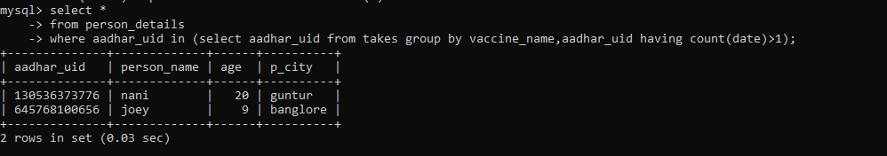
2.Output the details of persons who took more than one dose of any vaccine

Slide 42
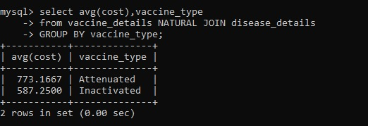
3.Find the average cost of all vaccine types

Slide 43
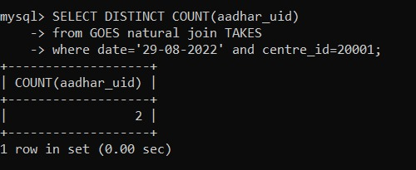
4.Find number of persons vaccinated in the centre with centre id 20001 on 29-08-2022

Slide 44
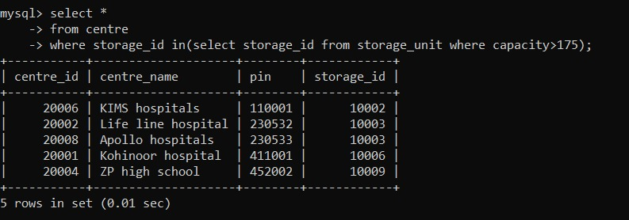
5.Find all vaccination centres which are connected to storage units with capacity greater than 175

Slide 45
Queries In Relational Algebra

Slide 46
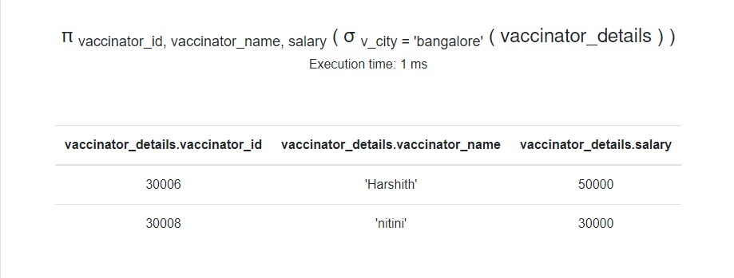
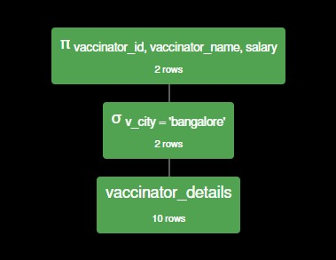
1.Find the vaccinator name, id, salary who live in bangalore

Slide 47
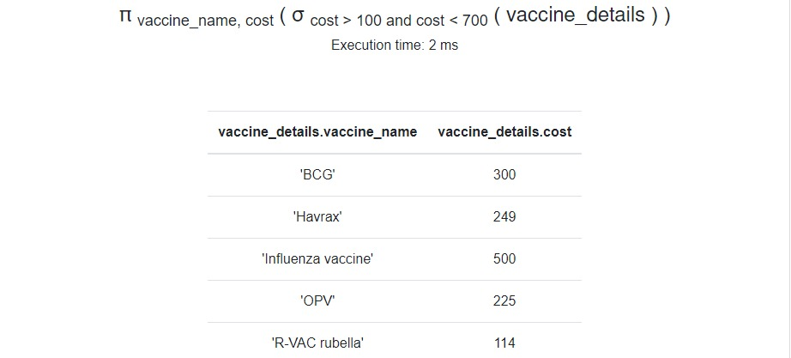
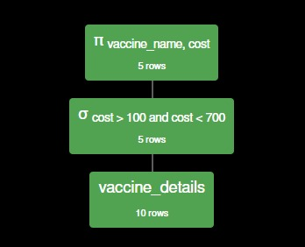
2.Find all the vaccines whose cost is greater than 100 and less than 700

Slide 48
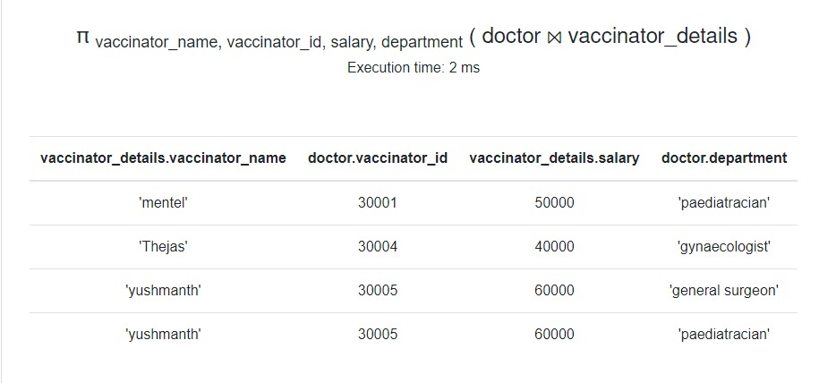
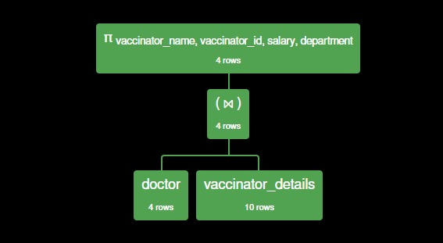
3.Find the vaccinator details who are doctors

Slide 49
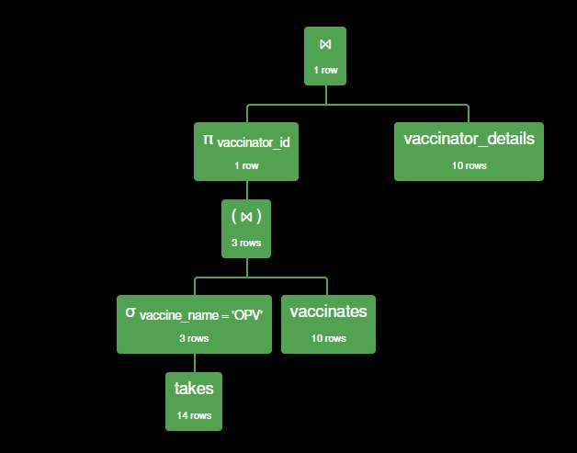
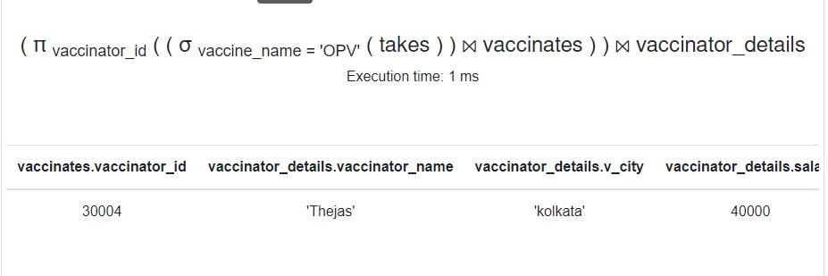
4.Find the vaccinator details who vaccinates OPV vaccine

Slide 50
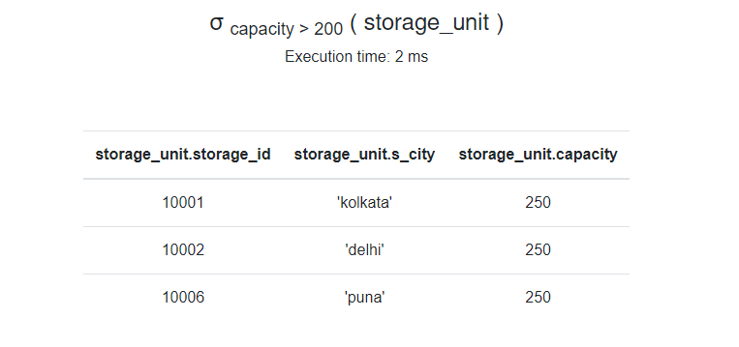
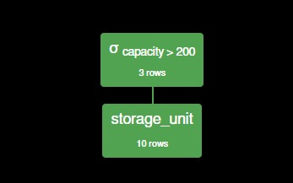
5.Find the storage unit whose storage capacity is greater than 200

Slide 51
THANK YOU

